Slide 1
Business Agile 101
Learn the basics of the agile methodology and how you and your team can take steps to apply it to your workflow

Slide 2
What is Agile?
Agile, originally software development methodology, is a project management framework that can be used throughout every aspect of the company to work faster and more efficiently.
Focused on speed and efficiency, the agile method also increases innovation by spending more time identifying the most important features or tasks that needs to be addressed for the customer to be successful. The idea behind looking at large problems in a different way; breaking them down into more finite chunks to work through with a creative and open mind. Agile is not only a framework, it is a mindset focused on the incremental and iterative delivery of a product or service.

Slide 3
Quick Starts for a More Agile Business
Create teams that are tasked with solving specific problems and following a workflow such as Scrum or Kanban
Embrace cloud project management tools employees can utilize such as Trello or Microsoft Planner
Shorten projects and timelines to deliver products and services more rapidly by focusing on delivery of an MVP (minimally viable product) and enhancing with each iteration and customer feedback.

Slide 4
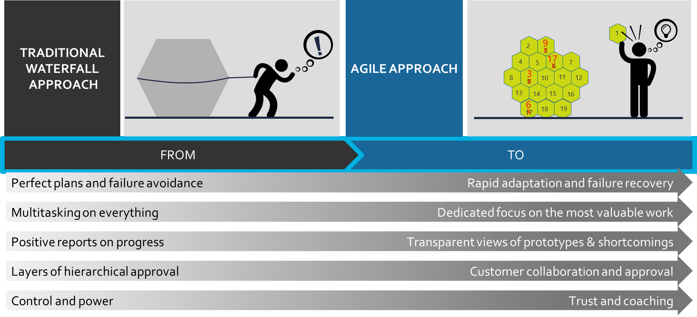
How the Agile approach is different
overall_0_131732874996111371 columns_1_131732874996111371
34_84 67_84 80_84 88_84 92_84 96_84 100_84

Slide 5
Agile impacts the ways team work…
overall_1_131744142960674562 columns_1_131744142960674562 7_1_131744153668339875 8_0_131744208217399434 15_0_131744215745836827 12_0_131744215745857179 18_0_131744218281419536 21_0_131744218281449593 35_0_131746728026892538 32_0_131746728055038877
Breaks down complex projects into smaller, more manageable pieces
Drives increased value by focusing team on one effort, rather than multitasking
Creates community by co-locating in local team rooms and video conferencing to stay connected, as well as transparency to project management boards for enhanced collaboration
Empowers the team by minimizing documentation and prototyping as they go
Clears roadblocks by addressing immediately or escalating to executive sponsors

Slide 6
Agile benefits
overall_1_131769112113121411 columns_3_131769112112965146 4_1_131769112109058506
6x success rate of conventional methods for large projects
69% of organizations achieved faster delivery
37% reduction in time-to-market
37% increase in revenue growth and 30% higher profits
20-40% higher employee NPS
40% of organizations report lower costs
63% increase in
product quality
72% of organizations better aligned business and IT
Source: Project Management Institute; Scrum Inc; Forrester; Bain

Slide 7
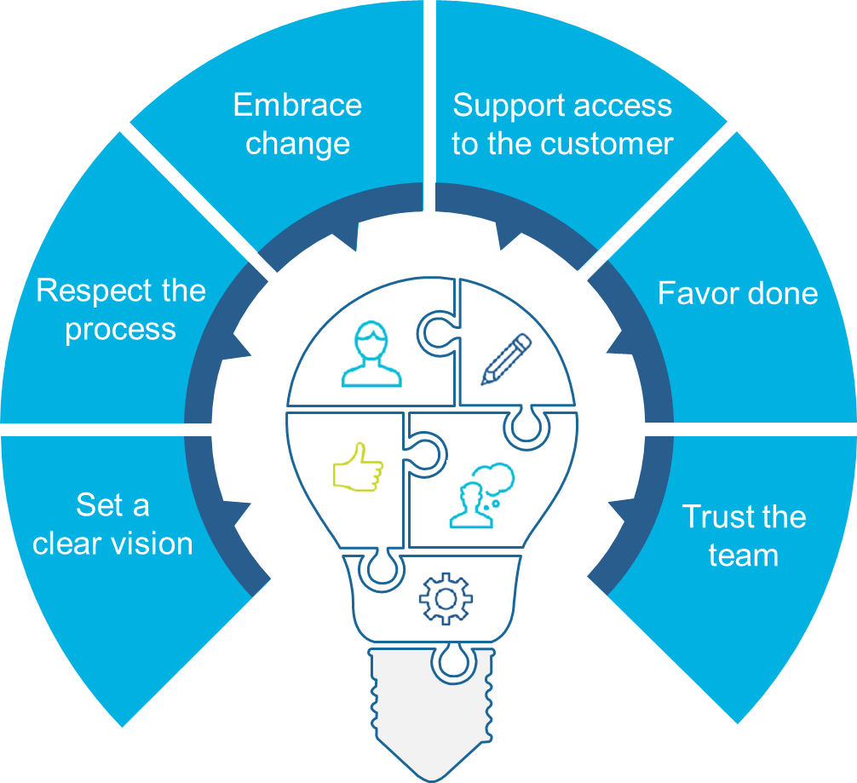
Tips for Agile Leaders: 6 Principles to Follow
overall_0_131763991391467349 columns_3_131767945755673224 7_1_131763991275542141 17_1_131767946370622908 18_1_131767946461990794
Expect change –
view as opportunity
Encourage the team to adjust based upon true customer input/feedback
Support access to the customer
Embrace
change
Respect the process and ways of working different to typical ‘waterfall’ project
Celebrate small, quick results
Give teams time for focus and deep work
Respect the process
Favor done
Articulate a clear vision for the Product Owner and Agile Team
Empower the Product Owner to decide WHAT gets done
Empower the team to decide HOW something gets done
Set a clear vision
Trust the team

Slide 8
Tips for Agile Leaders: Pitfalls to Avoid
overall_0_131763991391467349 columns_3_131767945755673224 7_1_131763991275542141 17_1_131767946370622908 18_1_131767946461990794
Agile Leadership Principles | Common pitfalls to avoid…
Set a clear vision | Providing user story that is vague; or incomplete acceptance criteria
Respect the process | Requesting long-term work plan ‘Back-channeling’ with the team
Embrace change | Defending current process (vs. focusing on opportunities for improvement)
Support access to the customer | Representing wants/needs of the customer Assuming expedience more critical than direct customer input and feedback
Favor done | Expecting ‘big deliverables’ from each sprint Pulling team away from agile commitments
Trust the team | Viewing oneself as the Product Owner Dictating WHAT to solve and HOW to solve it

Slide 9
Agile Frameworks: Popular options for teams to choose
Scrum and Kanban are two popular agile frameworks, built on agile principles that help define how your teams collaborate and tackle projects at hand.
Scrum tasks complex tasks and divides them into user stories (description of a project feature from the customer’s perspective) and visualizes them on a project board. Scrum teams commit to deliver the project at the end of set intervals (typically 2-4 weeks in duration), known as sprints. Scrum is a great way to deliver value to customers on a regular basis.
Kanban is about continuous delivery of projects and management of a small number of tasks, quickly and concurrently. Kanban teams make use of a Kanban board to guide their workflow. Teams display a project or user story on a board and move them through different stages through to completion. Kanban is ideal for teams with a continuous workflow.

Slide 10
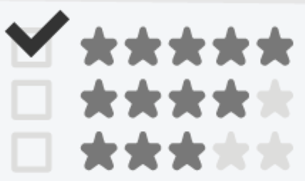

Agile Scrum Overview: Work is broken down to accelerate feedback loops
overall_1_131746296556409948 columns_1_131746296556409948
1
Backlog
5
Daily Standup
1. Idea A
Ruthlessly rank-ordered list of potential initiatives
Detailed planning only for
initiatives at top of backlog
15 minutes daily; team discusses progress, identifies barriers for quick removal
2. Idea B
3. Idea C
4. Idea D
Sprint Planning
1-4 week Sprint
Working
Prototype
Sprint Review
2
4
6
8
Team aligns on sprint goal and decides what it can commit to deliver by end of sprint
Team works iteratively and incrementally
Agile team showcases its work and gets feedback from customers, leaders, and other key stakeholders
Team adapts and
reprioritizes backlog
Delivers a real, working increment that is ready to give to users
3
Sprint Backlog
Visible, real-time list of prioritized tasks and definition of “done” for sprint
7
Sprint Retrospective
1. Idea A
Task A
Team identifies ways to continuously improve their process
Task B
Task C
Task D

Slide 11
Agile Scrum Overview: Standard Agile Team Roles
overall_0_131732851343317866 columns_3_131743750966969075 _1_131740957574723960 27_1_131740958301713567 36_1_131741513578544365 23_0_131743748321138682 32_0_131743750267258225 15_1_131767828088372194 8_1_131767827514917460 26_1_131767828088538148 30_1_131767828088704102 41_1_131767939387175596 46_1_131767941274286503 5_1_131767975372612255
11_89 12_89 13_89
Product Owner: The What
Scrum Master: The Process
Delivery Team: The How
Owns results
Defines vision and ambition – with input from management/leadership
Engages customers and stakeholders
Creates, organizes, and prioritizes the work (Product Backlog)
Synthesizes the benefits and metrics
Inspects and approves work
Oversees and facilitates agile process
Coaches the team; creates right environment for success
Identifies impediments
Escalates roadblocks as required to ensure work is moving
Protects the team; mediates with Product Owner
Brings variety of perspectives and disciplines to the team
Decides how to do and allocate the work (self-organizing)
Decides how much work they can do in a Sprint (self-managing)
Works together to achieve a Sprint Goal

Slide 12
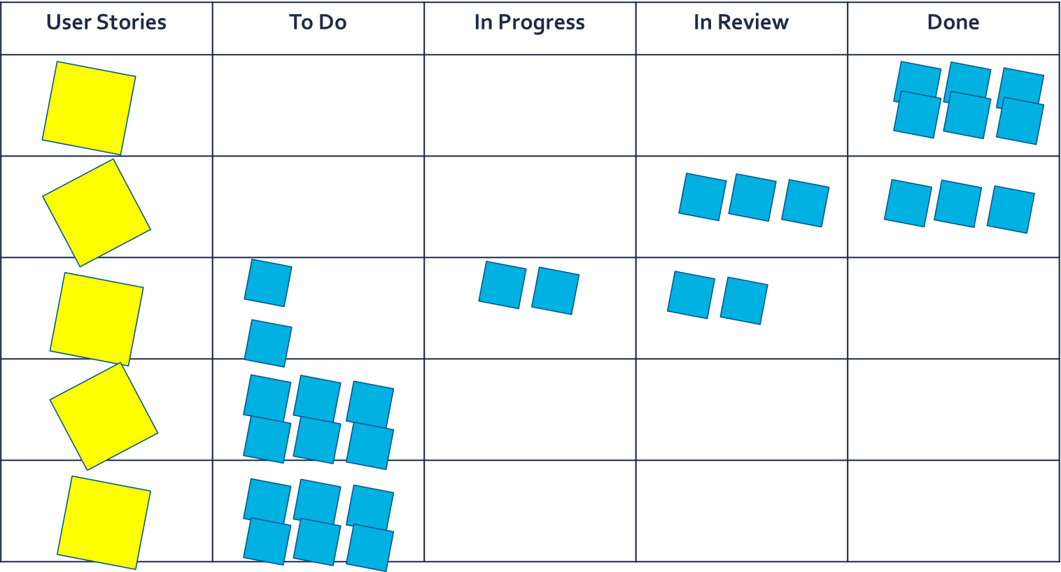
Scrum Backlog (Example)
Smaller, more manageable tasks are moved through the board to create product feature/fulfill user story.
User stories represent project features, presented from the viewpoint if the customer. User stories are them divided into smaller tasks.

Slide 13
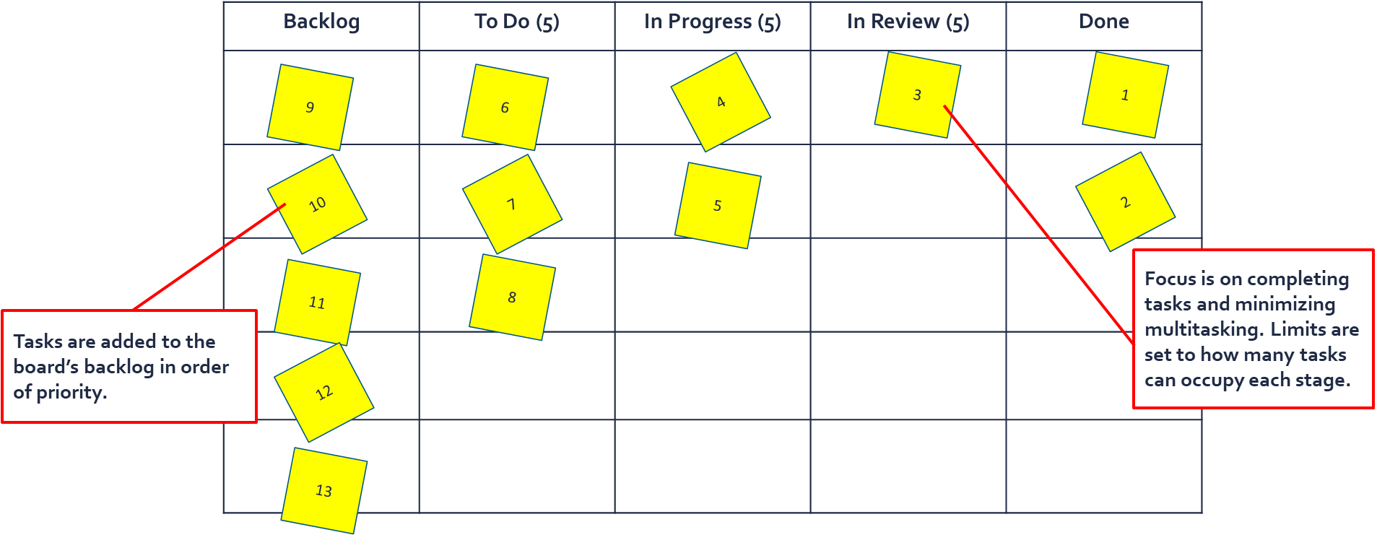
Agile Kanban Overview: Workflow is continuous
Kanban is an agile framework designed to optimize a continuous flow of work. The goal is on limiting work in progress, to produce a more efficient workflow. In Kanban, there are no defined sprints or roles, making it suitable for individual work management as well. A Kanban board is used to track work and unlike Scrum, there is greater flexibility for change.
Kanban Board (Example)

Slide 14


Dos and Don’ts for Agile Leaders
overall_0_131771355898763297 columns_3_131771345691702841 6_1_131771341989484852 33_1_131771345884863740
The agile approach can be uncomfortable to organizations using it for the first time.
To respect the process as a leader in your organization, try to follow the following guidelines:
You Should:
  Empower the Product Owner to decide WHAT gets done and the agile team to decide HOW something gets done
  Be accessible to the Product Owner to articulate a clear vision and provide feedback on the prototypes or finished work
  Embrace the ‘fail fast’ to learn mindset
  Celebrate results and recognize individuals for their achievements
You Should NOT:
  Ask for project milestones or long-term roadmap
  Do the forensics behind who is to blame for a ‘failure’
  Represent the needs or wants of the customer

Slide 15
Agile Best Practices
1
2
3
Be Adaptive
In our industry, change is inevitable. Plans and people must be flexible in order to remain competitive in the market. Welcome feedback and change throughout projects, and view failure as an opportunity to grow. Agile teams aim to continuously improve, not remain the same.
Focus on the Customer
Any Agile project only exists because a customer has asked for something. The customer is a person with a problem that you can help solve. Plan around their needs, listen to their feedback, and evolve your strategies as their requirements change.
Deliver High Value and High Quality
Agile is not just about making something happen fast. Speed is important, but what you deliver is more important. Focus on what brings the most value to the customer, and limit work in progress so those items are done right.

Slide 16
Agile Best Practices
4
5
6
Simplify
Accomplish tasks by focusing only on what is most important. Maximize the time spent on delivering what the customer needs, not on unnecessary work. Strive for efficiency while still delivering quality.
Communicate Constantly
Transparency is one of the main pillars of Agile. Communicate among teams and with customers as often as possible, preferably face-to-face. Be sure that everyone involved in a project is informed and aware of what is happening in the project.
Put Ownership on the Team
Agile practices aim to eliminate blame on individuals. Team members share responsibility for the whole project, not just certain aspects. If something goes wrong, the whole team must resolve the problem. If a project is successful, the whole team receives praise.

Slide 17
Agile Best Practices
7
8
9
Stand Up
Even if your team is not using a pure Scrum framework, daily standups are a great way to keep team members aligned on project progress and roadblocks. Standups foster improved communication and visibility among teams, and encourage teams members to share ideas and help each other succeed.
Visualize Work
When the work in a project is represented visually, it is easier for teams to recognize and concentrate on the highest priority tasks. Real-time displays of work allow teams to quickly respond to changes and easily identify bottlenecks in workflows in order to assist each other in resolving issues.
Reflect
Like standups, business retrospectives are a powerful Agile strategy. Teams should strive to improve continuously just like their products do. Hold team retrospectives regularly to determine what is and is not working well among the team and with customers to improve relationships and efficiency.

Slide 18
Additional Resources
How to Apply Agile to Your Non-Tech Team (blog)
How Business Teams Can Embrace Agile Techniques (blog)
Agile at Scale (Harvard Business Review article)
A Quick Introduction to Agile Management (Harvard Business Review video)
Having an Agile Mindset (blog)

