Slide 1
Empathy Map & Value Proposition Template
Better understand your customers and create compelling value propositions that will meet their needs!
This template & exercise is designed to help you create a customer Empathy Map that will help you develop a stronger customer-centric focus. Once you’ve completed your Empathy Map, you can move forward with the Value Proposition Template, and use your findings to assess product-market-fit and shape your products and services into more compelling value propositions.

Slide 2
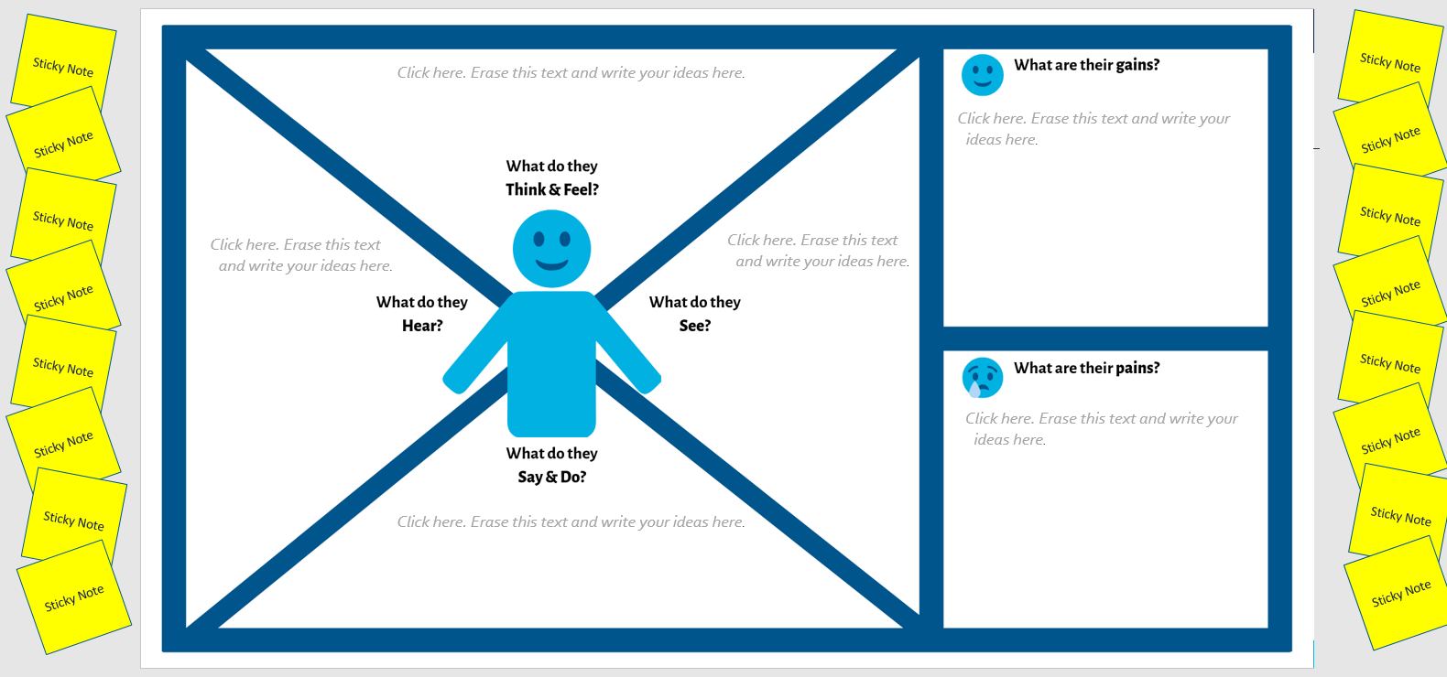
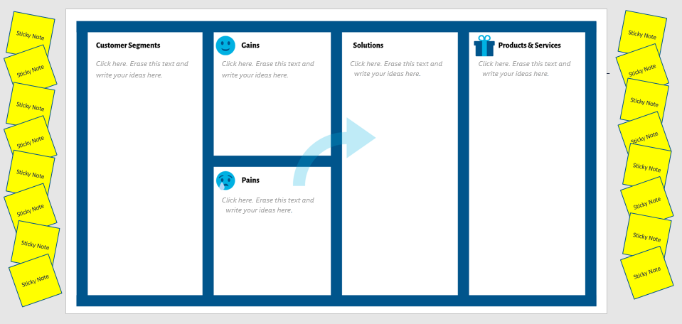
Table of Contents
03 - How to Create an Empathy Map
07 - Empathy Map Template
08 - How to Create Compelling Value Propositions
11 - Value Propositions Template
12 - Additional Resources
Click here to view Empathy Map template
Click here to view Value Proposition template

Slide 3
How to Create an Empathy Map
Activity Duration: 1- hour
Step 1: Set a time and date for you and your team to get together. Reserve a meeting space with a whiteboard or projector, so you can work collaboratively. Plan aside one hour for each customer persona you will create.
Step 2: Gather your team. Your team should include your action team members, including your marketing lead, but also consider including other members of your organization who are customer-facing and responsible for creating products or experiences that will come in touch with your audience.
Step 3: Collect your research. Ask your team to collect as much customer research as possible. If this is not feasible, your empathy map can be created based on current stakeholder knowledge.
Step 5: Create your map using the template on SLIDE 7. Kick-off your meeting by identifying the persona(s) you will be focusing on. Then, one by one work your way through the quadrants of your empathy map.

Slide 4
How to Create an Empathy Map
Tip: Consider projecting the template on SLIDE 7 on a whiteboard, and provide your team members with sticky notes and pens to fill in their responses on the map. Add a photo or illustration of your customer at the center of your map to make it feel more real. Then, work your way through the quadrants on your map together.
Step 5 (continued): Work your way through the quadrants on the map:
Fill in how the customer THINKS and FEELS What matters to your customer? What are their concerns? What are their attitudes toward your services and products?
Fill in what the customer SEES What is your customer exposed to in their environment?

Slide 5
How to Create an Empathy Map
Fill in what the customer HEARS What and who influences your audience (customers, family, industry, etc.). Where do the get their information from? Which channels do they receive information?
Fill in what the customer SAYS and DOES What are your customer’s actions? What do they say? Who do they influence? (If available, include collected quotes from customers here)
Fill in the customer’s PAINS What are your customer’s challenges and pain points?
Fill in the customer’s GAINS What is considered success for your customer? What are they wanting to accomplish?

Slide 6
How to Create an Empathy Map
Step 6: Share Your Map. Be sure to document your completed empathy map to share with your colleagues so they can reference it as they create experiences for your customers and engage with them. Revisit this activity as customer insights evolve.
Step 7 (Optional): Create Compelling Value Propositions. Once you have completed your empathy map, you can move forward and utilize the Value Proposition Template on SLIDE 7 to revise your value propositions into compelling points from the customer perspective, and assess products and services for product-market-fit. Plan to add an extra hour to your workshop, if you would like to complete this activity during the same session.

Slide 7
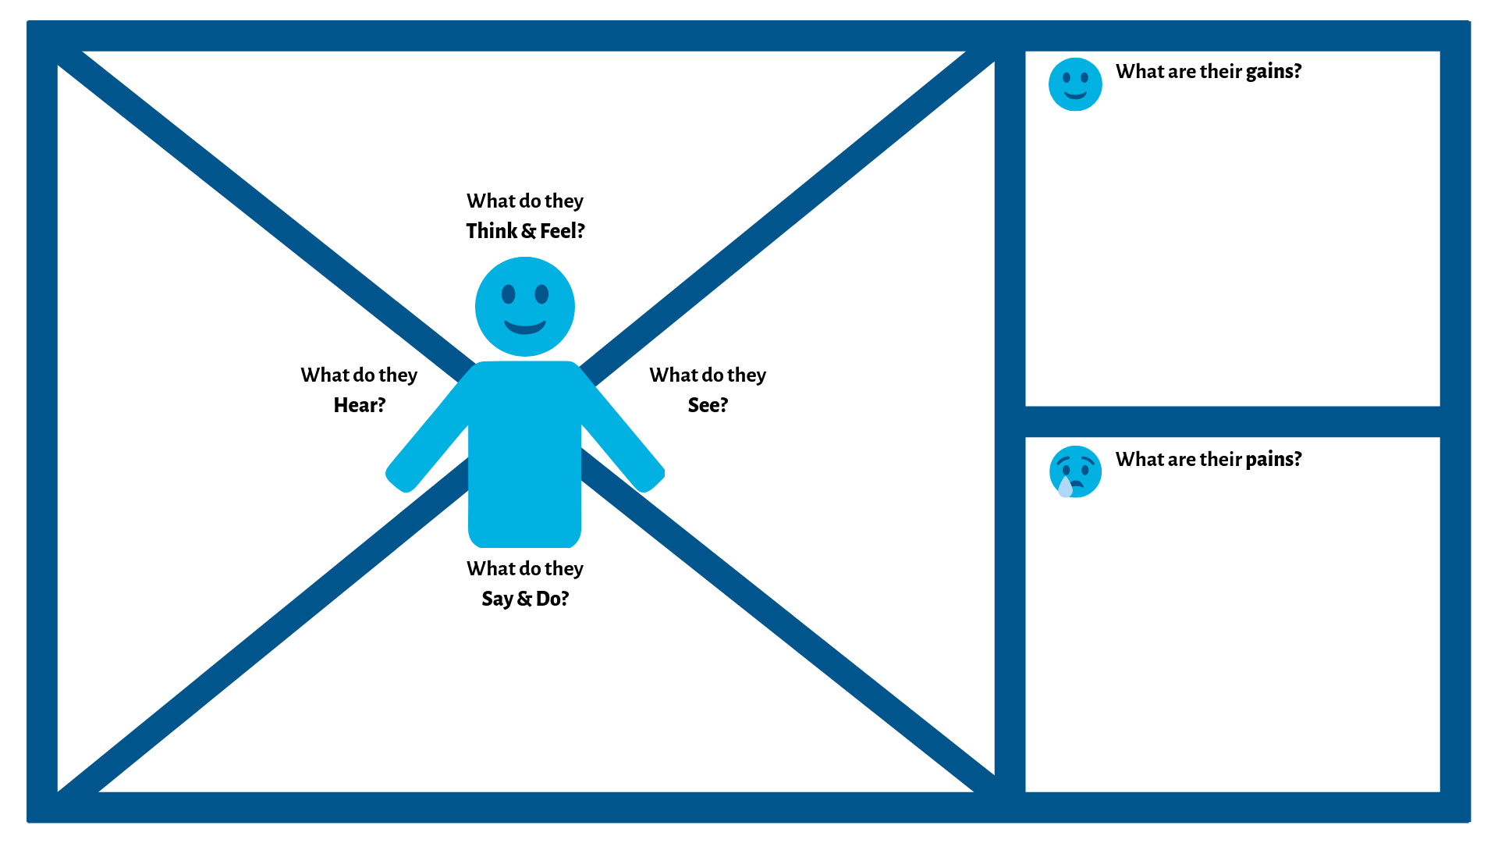
Empathy Map Template
Empathy Map Template
Sticky Note
Sticky Note
Click here. Erase this text and write your ideas here.
Sticky Note
Sticky Note
Click here. Erase this text and write your ideas here.
Sticky Note
Sticky Note
Click here. Erase this text and write your ideas here.
Click here. Erase this text and write your ideas here.
Sticky Note
Sticky Note
Sticky Note
Sticky Note
Sticky Note
Sticky Note
Click here. Erase this text and write your ideas here.
Sticky Note
Sticky Note
Click here. Erase this text and write your ideas here.
Sticky Note
Sticky Note
This template is adapted from the Empathy Map by XPLANE and variation by We Design Thinking.
This template is licensed under the Creative Commons Attribution-Share Alike 4.0 Unported License.
To view a copy of this license, visit https://creativecommons.org/licenses/by-sa/4.0/
or send a letter to Creative Commons, 171 Second Street, Suite 300, San Francisco, California, 94105, USA.

Slide 8
How to Create Compelling Value Propositions
Activity Duration: 1- hour
Effective value propositions are less about a product’s description or listing of features, and more about how and why it meets customers’ needs and desires. In other words, your value propositions should connect what you make with why your customers buy it.
Use the Value Proposition Template on SLIDE 9 to match your offer to reflect the needs and desires of your customer. It is suggested that you use your completed empathy map side-by-side with this tool.
Step 1: Use the template on SLIDE 9. The left-side identifies customer characteristics (which you should be familiar with now that you’ve completed your empathy map), while the right-side highlights your solutions, products and services.

Slide 9
How to Create Compelling Value Propositions
Tip: You may project this template on a wall, or write it out on a whiteboard. Be sure to document your team’s results so you can utilize it regularly.
Step 1 (Continued): Work your way through all of the templates five quadrants with your team, responding to the following questions:
Identify your customer segments. Who are your customers? What jobs do they do?
Fill in customer pains. What are challenges your customer encounters, including negative experiences?
Fill in customer gains. What is considered success for your customer? What are they wanting to accomplish?

Slide 10
How to Create Compelling Value Propositions
Solutions What are solutions that can help minimize customer pains and maximize their gains?
Products and Services How do your products, or how can they provide the solutions you identified?
Step 2: Rewrite your value proposition(s) in one sentence (10 words or less). Now that you’ve completed your value proposition template and created clear linkages between your customer’s experiences and your products and services, you can better create compelling value proposition statements. The best value propositions are clear and straight to the point. If it takes more than one sentence to articulate, go back to the drawing board.
Alexander Osterwalder & Yves Pigneur, identify the following as key elements included in compelling value propositions in their book, Business Model Generation: Newness, Performance, Customization, “Getting the job done”, Design, Brand/status, Price, Cost reduction, Risk reduction, Accessibility, and Convenience/usability.

Slide 11
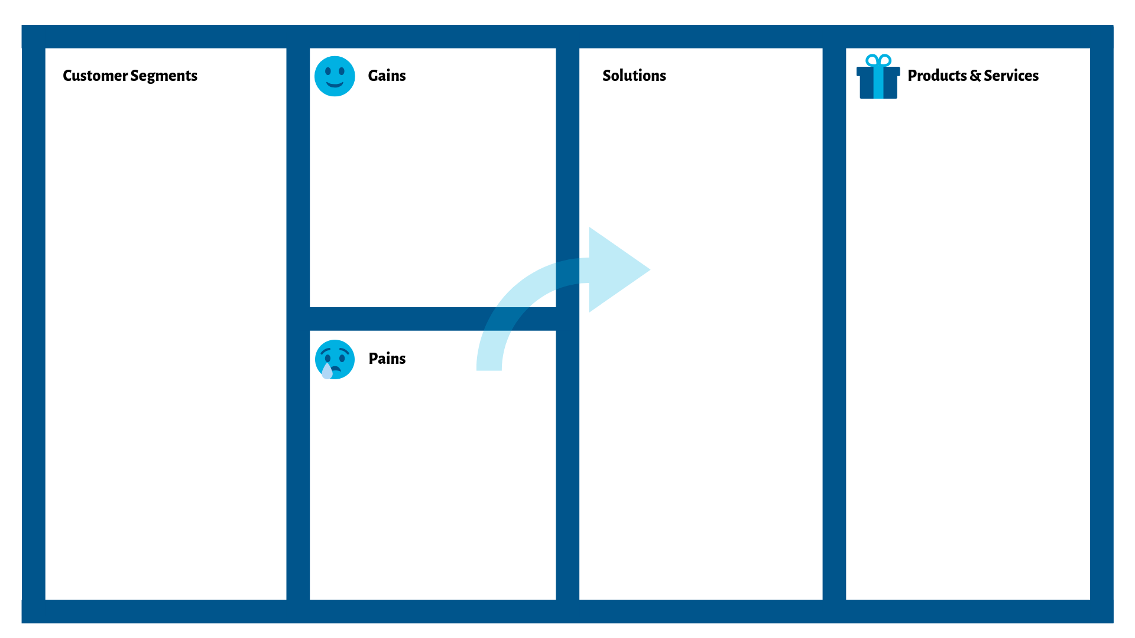
Value Proposition Template
Sticky Note
Sticky Note
Sticky Note
Sticky Note
Click here. Erase this text and
write your ideas here.
Click here. Erase this text and
write your ideas here.
Click here. Erase this text and write your ideas here.
Click here. Erase this text and write your ideas here.
Sticky Note
Sticky Note
Sticky Note
Sticky Note
Sticky Note
Sticky Note
Sticky Note
Sticky Note
Click here. Erase this text and write your ideas here.
Sticky Note
Sticky Note
Sticky Note
Sticky Note
This template is adapted from the Value Proposition Design Template by We Design Thinking.
This template is licensed under the Creative Commons Attribution-Share Alike 4.0 Unported License.
To view a copy of this license, visit https://creativecommons.org/licenses/by-sa/4.0/
or send a letter to Creative Commons, 171 Second Street, Suite 300, San Francisco, California, 94105, USA.

Slide 12
Additional Resources
Ten Tips to Develop Better Empathy Maps (blog)
The Practical Guide to Empathy Maps (blog)
Value Proposition Design by Alexander Osterwalder & Yves Pigneur (book)
Business Model Generation by Alexander Osterwalder et al. (book)
Creatlr.com (visual thinking and collaboration tools)

