Slide 1
Persona Template
Understand your customers' mindset and desires and make better informed marketing decisions by creating personas for each of your partner segments.

Slide 2
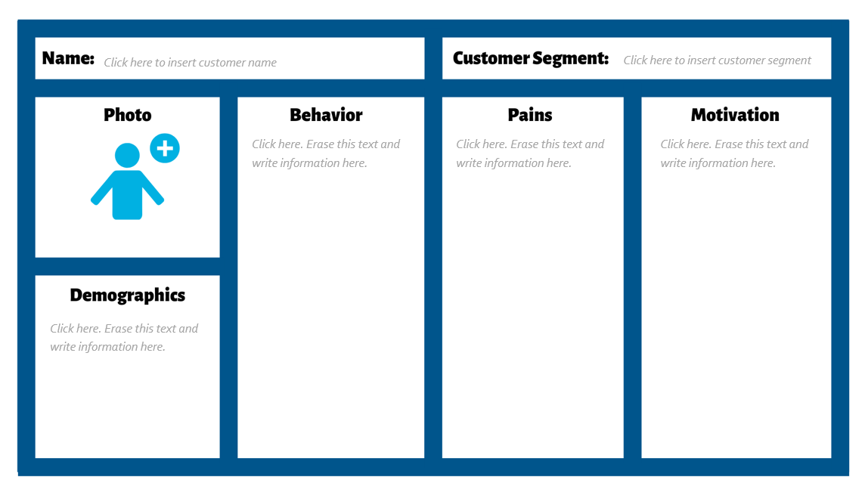
Table of Contents
03 – Why Create Personas
04– How to Create Customer Personas
08 – Persona Template
09 – Persona Example
10 - Additional Resources
Click here to view Persona Template
Click here to view Persona Example

Slide 3
Why Create Personas
A customer persona is a fictional character combining essential traits of your customer base. You can create customer personas for each of your audience segments.
Customer personas can be shared throughout your organization, with your marketing teams so they can generate winning campaigns and your customer-facing staff to prepare them to close deals faster and offer the best customer service possible. Not only do customer personas help you cater to your customer, they help you empathize with your customer and recognize them as real people with specific needs.

Slide 4
How to Create Customer Personas
Follow the steps below to build your own customer persona, then utilize the template on SLIDE 6 to bring them to life. Steps 1-4 focus on gathering research and information on your partner, while steps 5-8 will help you build your persona.
Step 1: Conduct Audience Research. Conduct research on your current customer base, utilizing data already at your dispense. For instance, a customer list can reveal a lot about the specific jobs your customers have. You can even use social media as a research tool to observe traits such as specific jobs your customers have and what they care about, and even observe discussion boards or groups to understand them better. Supplement this research with other methods, such as customer interviews, surveys and focus groups. See the Persona Example on SLIDE 9 for key data points to include.
Also engage in secondary research, interpreting existing data from reports (e.g., Gartner, IDC, etc.)

Slide 5
How to Create Customer Personas
Step 2: Leverage Your Analytics Tools. Analytics tools can show valuable demographic information. Adding a Google Analytics embed code on your website can show who is driving traffic to your page and display user age, gender and interest categories, and social media platforms, such as Facebook, can reveal and breakdown demographics by age, nationality, city and language.
Step 3: Analyze your competitors. Research your competitors media channels, and analyze who they are targeting. Are they similar groups? Should you target this audience as well or not?
Step 4: Engage in social listening. Social media management tools like Hootsuite, Sprout Social and Sprinklr allow you set up search streams and engage in social listening. See and observe how your target audience mentions your products, industry, competitors, etc., by setting filters for specific keywords.

Slide 6
How to Create Customer Personas
Step 5: Identify customer challenges. Based on the research you’ve collected, identify the challenges and pain points your customer experiences. You can also engage with your stakeholders and customer-facing teams to identify which questions partners are asking the most, revealing what their common barriers are.
Step 6: Identify their goals. Knowing your customer's goals whether or not it relates directly to your products and solutions can help you develop a tone in your messaging aligned with what they want to achieve. Speak with your customer-facing teams to better understand their motivations.
Step 7: Identify how your brand serves your customers. Once you understand your customers needs, how do your products and services help them minimize their pain points and maximize their goals? What are the benefits of your product? How does it serve your customers?

Slide 7
How to Create Customer Personas
Step 8: Create your persona! Review your research and find common characteristics between your customers. Transform your findings into profiles representing each of your customer segments. Your profiles should include: Names, job titles, demographic information, jobs to do, pains and motivations, but can be expanded to include bios and quotes. While this information is fictional and represents a broad sample of your customer segment, they help you recognize your customers as real people and empathize with them.
Use the persona template on the SLIDE 8 to fill in your findings and develop your completed persona(s).
Share your personas with your team and use them to inform your messaging and key business decisions, keeping customers central to the process. Revisit your personas and revise them regularly as your customer experiences alter and expand.

Slide 8
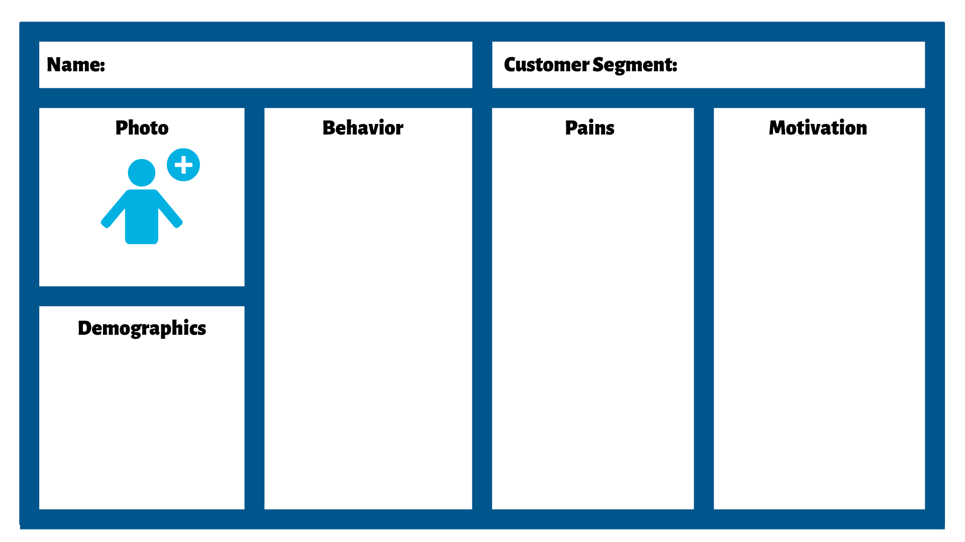
Persona Template
Persona Template
Click here to insert customer name
Click here to insert customer segment
Click here. Erase this text and
write information here.
Click here. Erase this text and
write information here.
Click here. Erase this text and
write information here.
Click here. Erase this text and
write information here.

Slide 9
Persona Example

Slide 10
Additional Resources
20 Questions to Ask When Creating Customer Personas (blog)
How to Identify and Speak to Your Customer Personas (blog)
Understanding Audiences: The Key to Your Marketing Campaign’s Success (SmartGuide)
The Basics of Google Analytics (SmartGuide)

