Slide 1
Golden Circle Pitch Template
Position your value position to influence your customer's behavior from the start, by leading with "Why"

Slide 2
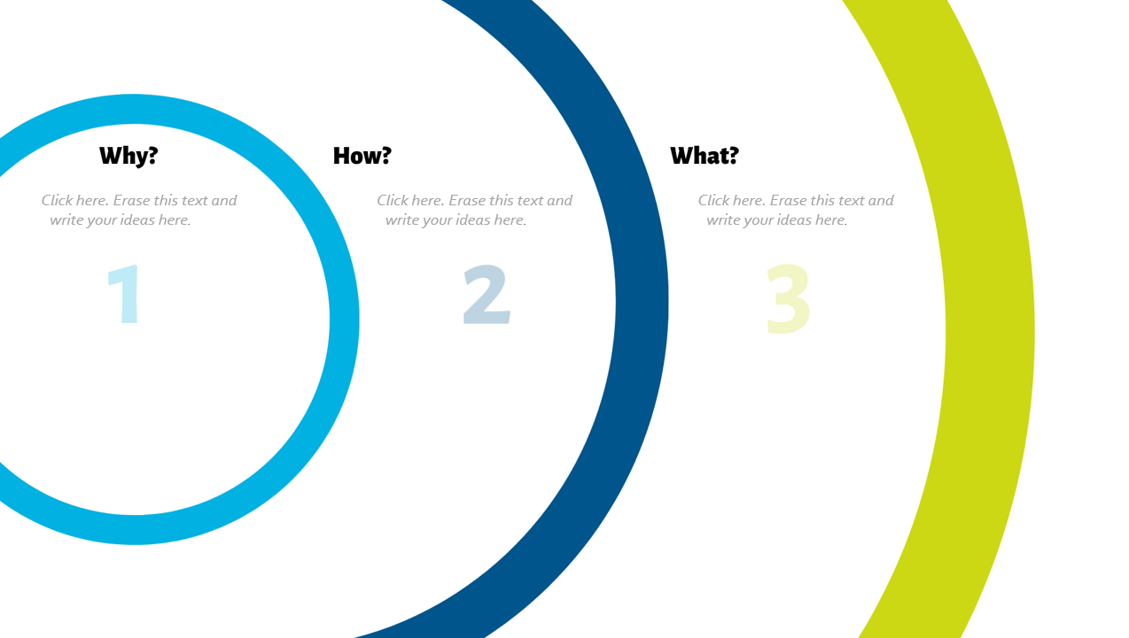
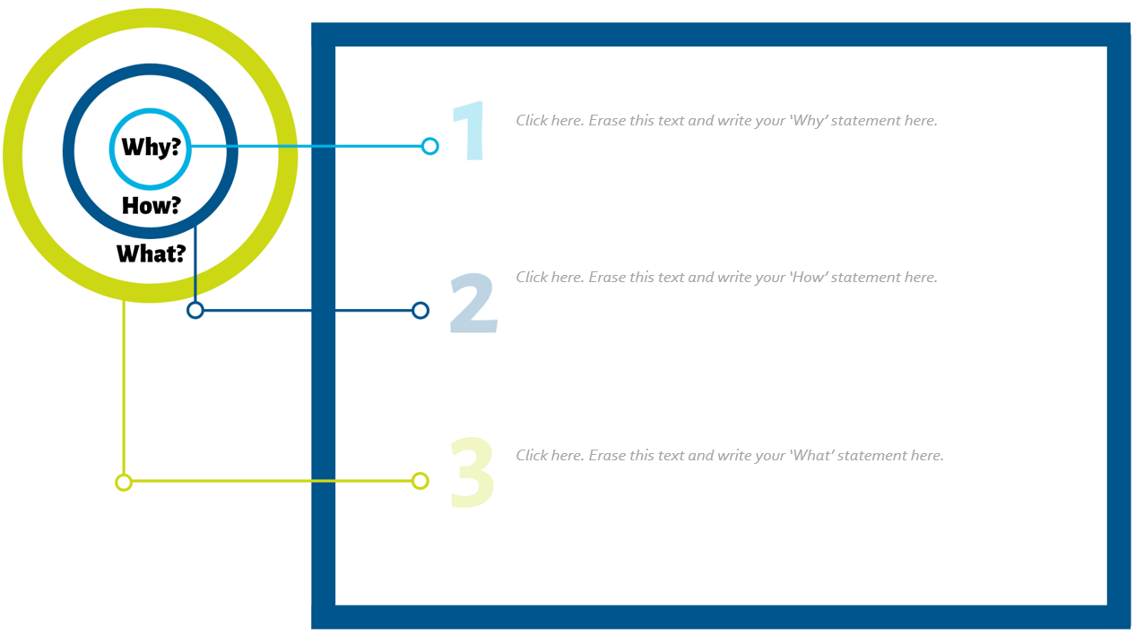
Table of Contents
03 – About the Golden Circle Pitch
06– How to Create a Golden Circle Pitch
07 – Golden Circle Pitch Mind Map
08 – Golden Circle Pitch Template
09 - Additional Resources
Click here to view the Golden Circle Pitch Mind Map
Click here to view the Golden Circle Pitch Template

Slide 3
About the Golden Circle Pitch
In his TED talk, How Great Leaders Inspire Action, Simon Sinek demystifies the success and influence of great leaders such as Martin Luther King and how they effectively mobilized audiences into action. As he suggests, they started their messaging and how they approached their mission with ‘Why’ – the heart and essence of why they are doing what they are doing; their purpose behind their motivations and how it would impact the world in a positive way.
Every business and organization has the ability to similarly influence their audiences by starting with ‘Why’, and Simon Sinek introduced the concept of the Golden Circle as a way for organizations to reinvent their value proposition into one that will actually influence customer behavior. This approach is grounded in the process of human decision-making.

Slide 4
About the Golden Circle Pitch
According to Sinek, every organization operates on three levels:
What you do: The products and solutions you sell and services you offer
How you do what you do: The way in which your products and services are delivered, and how you are uniquely differentiated and unique
Why: Your purpose, what motivates and inspires you
In general, most people are very good at expressing what they do and how they do it, but have trouble articulating why they do what they do and often leave this out of the conventional pitch.
Sinek suggests, remodeling your pitch in the following order to tell the most compelling story: (1) Why you do what you do; (2)How you do it; and (3) What you do.

Slide 5
About the Golden Circle Pitch
While ‘What’ you do is a clear pointed way to inform you customer and may capture their attention in the short term it is not a way to keep them. No matter how great or inexpensive your product and offer, you are always at risk to become dispensable when a better product or deal comes past your customer. Research shows, customers would rather pay more for a brand they believe in.
Why goes beyond monetary motivations, is more about why you exist, the purpose you serve, the reason you wake up every morning to do what you do. Why shows your customers why they should care about you. Why shows your customers why they should have trust and be loyal to your brand.
Follow the directions on the next slide to learn how to create your golden circle pitch, and use the included template to brainstorm, and rewrite a pitch that is truly “golden”.

Slide 6
How to Create a Golden Circle Pitch
Time Duration: 1 hour
Step 1: Write your conventional pitch. Start by writing down the elevator pitch for your company as it is today.
Step 2: Create your golden circle mind map. Use the template on SLIDE 7 to create a mind map of What You Do and How You Do it. Then reflect and brainstorm Why you do it.
Step 3: Write your golden circle pitch. Now, using the template on SLIDE 8 rewrite your pitch, but now starting with why and moving to the other points.
You can apply this exercise to every practice and product in your business.

Slide 7
Golden Circle Mind Map
Click here. Erase this text and write your ideas here.
Click here. Erase this text and write your ideas here.
Click here. Erase this text and write your ideas here.
This template is inspired by the Golden Circle method by Simon Sinek and an adaptation of the template created by We Design Thinking.
This template is licensed under the Creative Commons Attribution-Share Alike 4.0 Unported License.
To view a copy of this license, visit https://creativecommons.org/licenses/by-sa/4.0/
or send a letter to Creative Commons, 171 Second Street, Suite 300, San Francisco, California, 94105, USA.

Slide 8
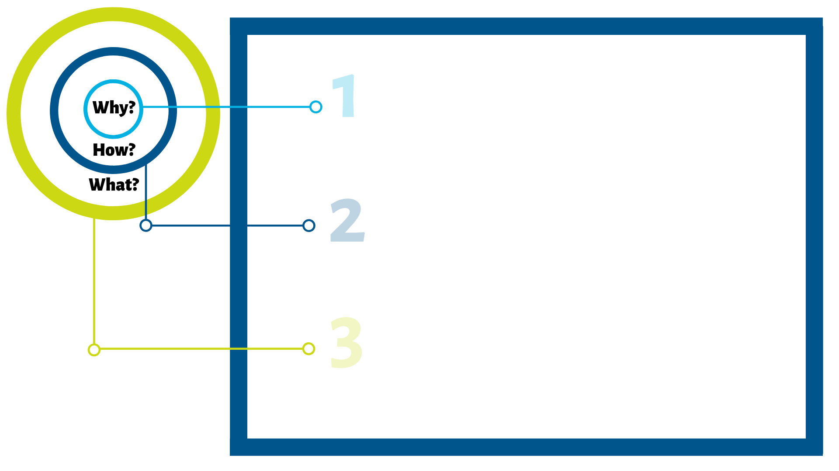
Golden Circle Pitch
Click here. Erase this text and write your ‘Why’ statement here.
Click here. Erase this text and write your ‘How’ statement here.
Click here. Erase this text and write your ‘What’ statement here.
This template is inspired by the Golden Circle method by Simon Sinek and an adaptation of the template created by We Design Thinking.
This template is licensed under the Creative Commons Attribution-Share Alike 4.0 Unported License.
To view a copy of this license, visit https://creativecommons.org/licenses/by-sa/4.0/
or send a letter to Creative Commons, 171 Second Street, Suite 300, San Francisco, California, 94105, USA.

Slide 9
Additional Resources
How Great Leaders Inspire Action (TED talk)
StartwithWhy.com
Start with Why by Simon Sinek (book)

